Slide 1
Taking Advantage of Utility Programs
They Already Do a Lot of What You’re Developing

Slide 2
As You Develop a Green Lending Program, Here Are Some Questions You Might Be Asking
What kinds of projects and technologies should I finance? Should I have any technical specifications?
How should I measure energy savings impacts?
How do I know whether the contractors installing the projects are reputable?
What kind of requirements should I have for energy audits? How can I make sure I understand them?
How do I know whether a proposed project makes sense?
Where can I get market data that can help me figure out demand and opportunity?
How can I reach potential borrowers?
How can I provide technical assistance to borrowers to help them understand the best opportunities for them?
How should I set pricing, and how can I offer competitive pricing while managing costs and risks?
How will I know whether my program is effective, and what if any changes I should make?

Slide 3
MYTH
Utility Programs Only Provide Rebates and Incentives.
FACT
Utility Programs Do Way More Than That. Use Their Resources!

Slide 4
MYTH
Utilities Just Want to Sell More Energy to Maximize Their Profits.
FACT
Many Utilities Are Directly Compensated for Saving Energy.

Slide 5
A bit of context… (a.k.a., a crash course in utility regulation in a single slide)
Most utilities are regulated by state public utility commissions (PUCs).
PUCs have the authority to determine what rates utilities can charge their customers, including different rates for different services, customer types, end uses, time of day, etc.
Utilities have to charge their customers for both the energy they use and for the infrastructure needed to provide that energy, in order to cover their costs.
Utility programs that help customers save energy reduce the overall total cost of providing utility services.
Offering those programs is often cheaper than it would be to provide the energy instead of saving it.
SO… utilities can help customers save energy at a lower cost, charge a higher margin, but still keep total charges below what they otherwise would be. They make more profit off of the higher margin from saving energy, even if the total amount they charge customers is less.
Many PUCs have helped set rates that allow utilities to take advantage of this fact.
But PUCs require that utilities track and report the savings from their programs very closely, to keep them from gaming the system.
By and large, the more they save, the more money they make. In order to maximize savings, they need robust programs that do a lot more than hand out cash.
As a lender, you can and should take advantage of these resources.

Slide 6
What kinds of projects and technologies should I finance? Should I have any technical specifications?
Utility programs already have comprehensive lists of eligible technologies, project types, and specifications that have undergone rigorous technical analysis.
You can just say, “If it’s eligible for the local utility program, you can finance it.”
A lot of lenders already do this.

Slide 7
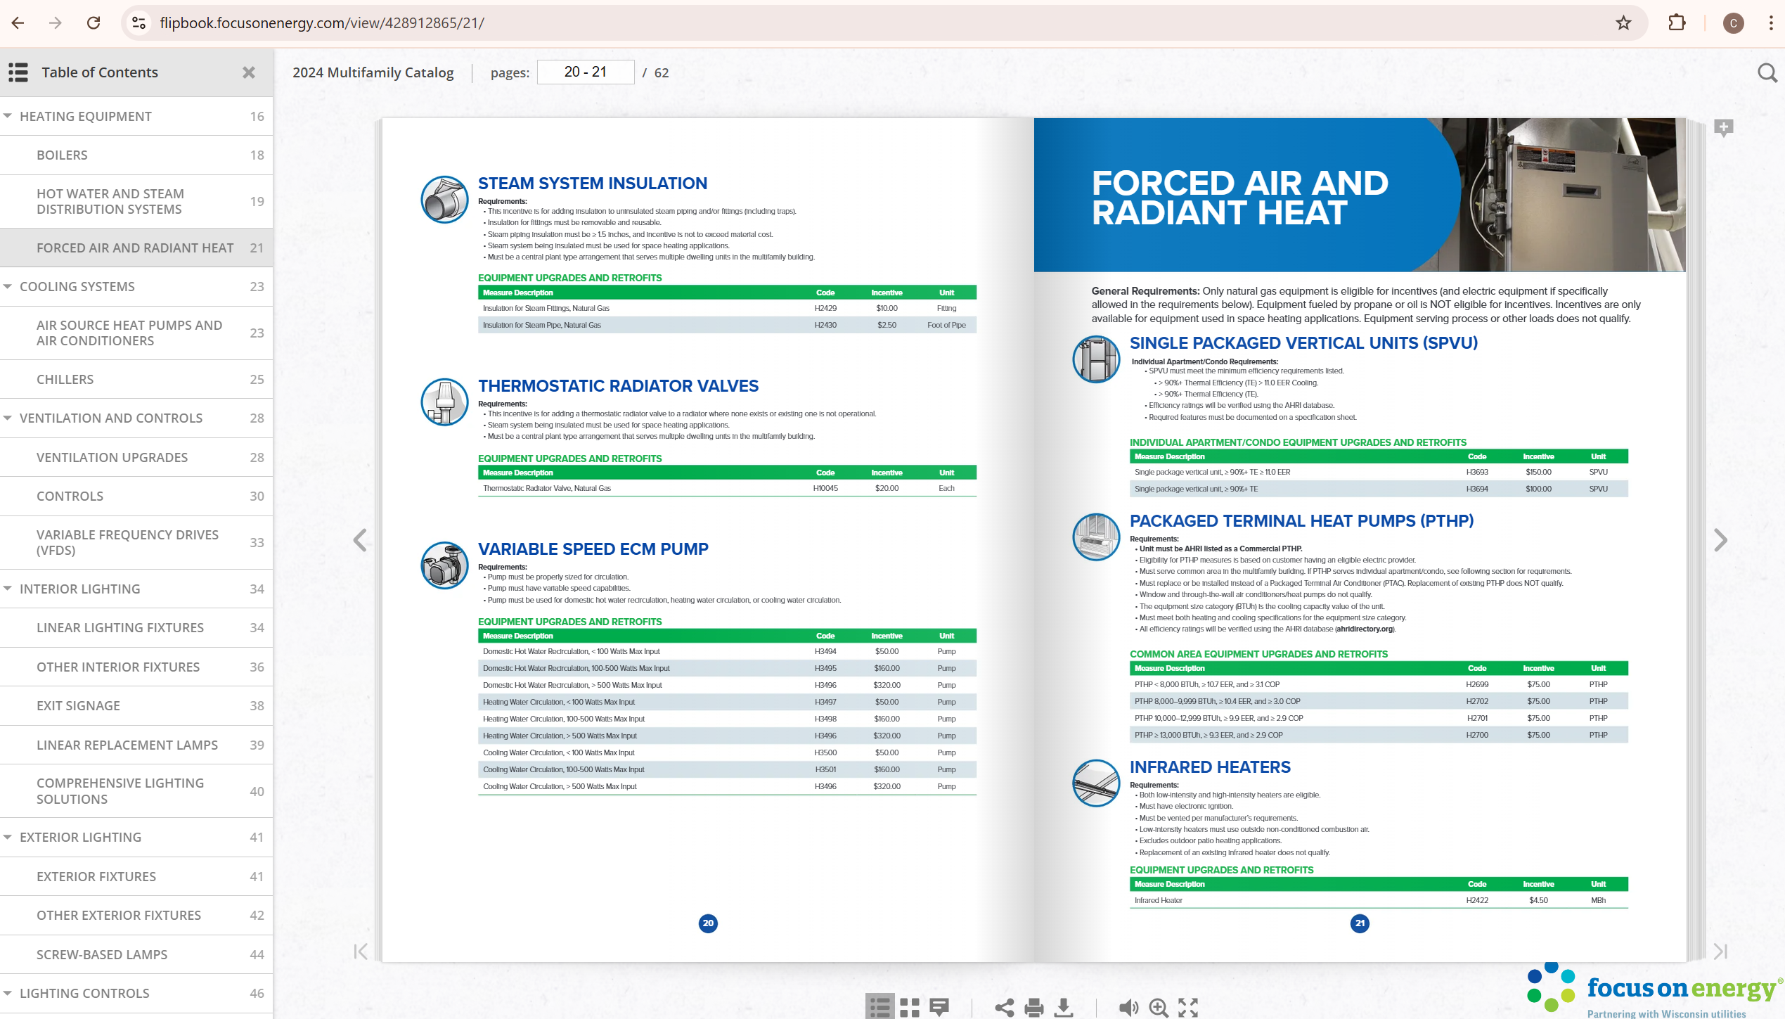

Slide 8
How should I measure energy savings impacts?
Utility programs are required to measure energy savings rigorously because they have to meet energy savings targets in order to be compensated for investing in their programs.
You can adopt the same methodologies.
If you partner with utilities, they’ll figure out the savings impacts for you.
Utility “impact evaluations” retrospectively further review and verify these reported savings.

Slide 9
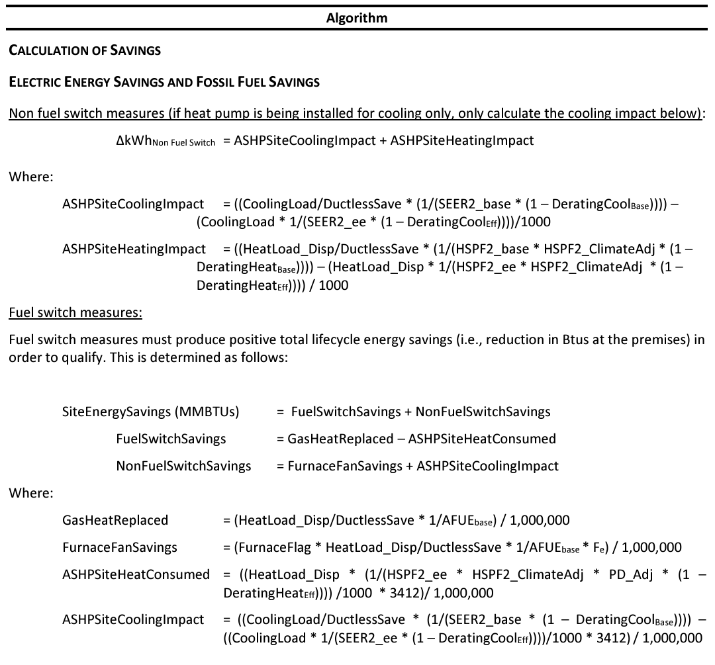
Example: Heat Pump Savings Algorithm
https://www.ilsag.info/wp-content/uploads/IL-TRM_Effective_010125_v13.0_Vol_3_Res_09202024_FINAL.pdf

Slide 10
How do I know whether the contractors installing the projects are reputable?
Utility programs typically have contractor eligibility requirements and often have their own lists of approved contractors.
You can adopt the same list.
Alternatively, you can consider it a plus factor in your risk assessment if a contractor is a member of the utility contractor network.

Slide 11
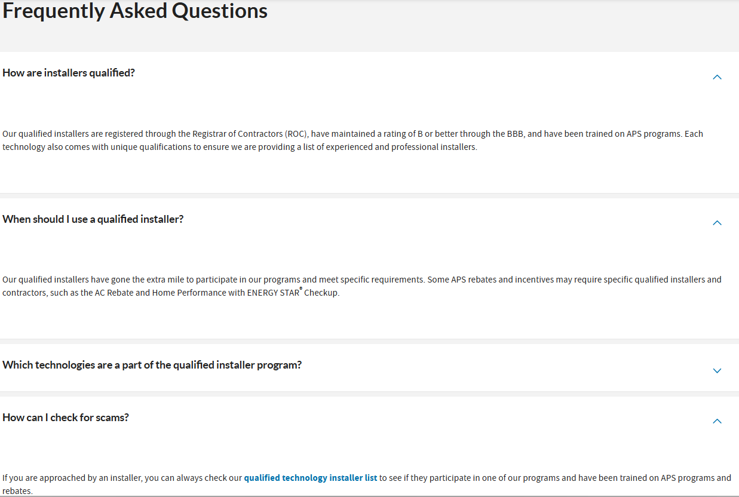

Slide 12
What kind of requirements should I have for energy audits? How can I make sure I understand them?
Utility programs often have requirements for different types of energy audits in single-family, multifamily, and commercial buildings.
You can adopt the same requirements.
In some cases, this may include designated software that the utilities have developed or approved.
They often have related requirements and technology for savings estimation and project scoping.

Slide 13
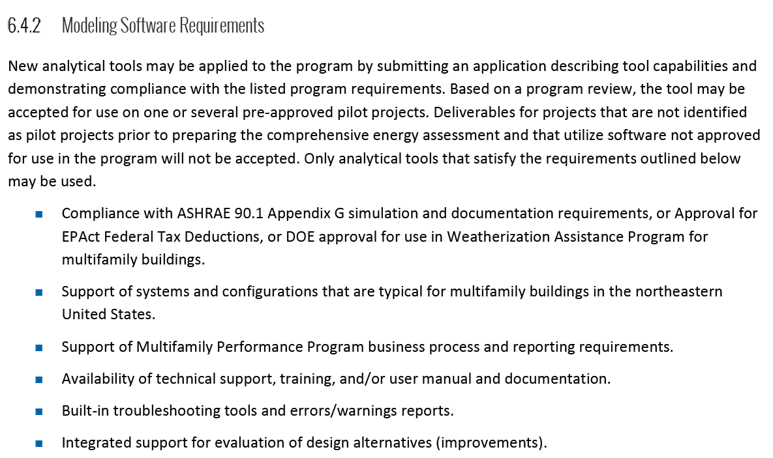
https://www.nyserda.ny.gov/ny/MPP-Existing-Buildings/Document-Library

Slide 14
How do I know whether a proposed project makes sense?
For single family customers, utility programs typically have staff who advise customers about the best options to help them save energy and who can help review a project scope.
Utility programs offer the same services in other sectors, and often also have programs to review custom projects.
If you partner with a utility program, they can provide the technical project reviews.

Slide 15
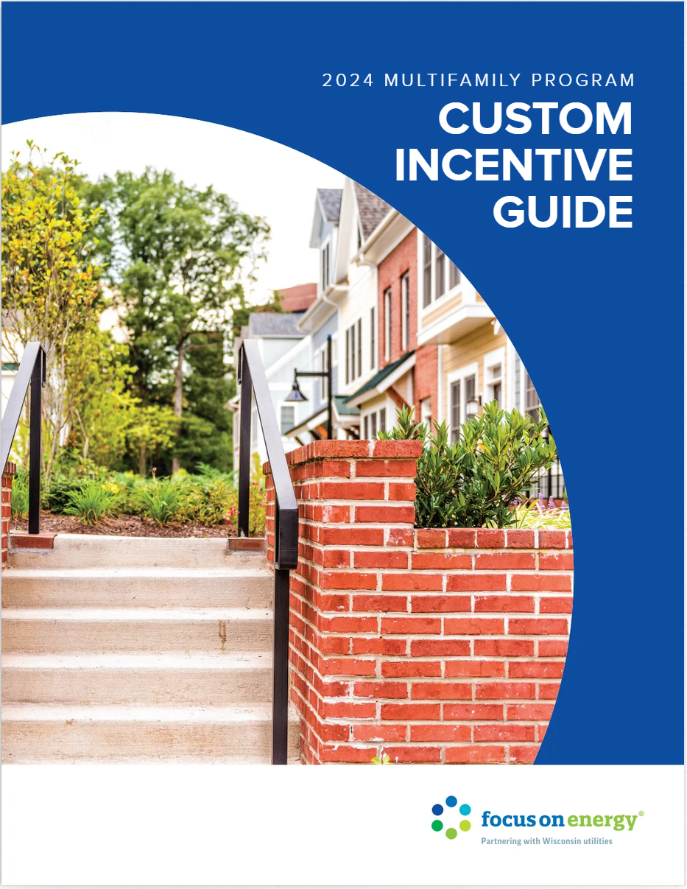
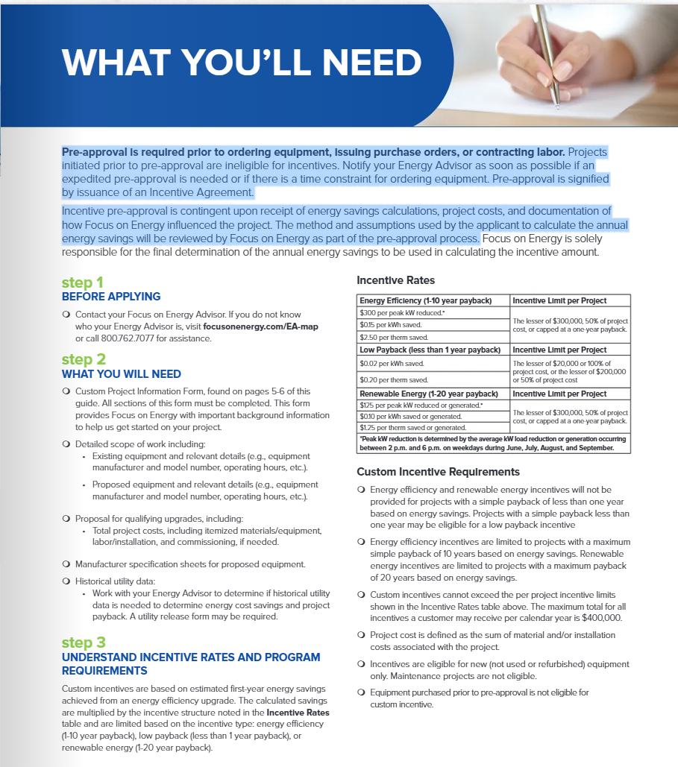
https://flipbook.focusonenergy.com/view/278280659/2/

Slide 16
Where can I get market data that can help me figure out demand and opportunity?
Utilities have direct access to energy use data from their customers. Combined electric and gas utilities have both. Utilities in states with delivered fuels (oil, propane, and wood) may not have that data directly, but they often have a good handle on those market also.
Energy usage data gives utilities deep insight into the needs and opportunities in the building stock, and increasingly sophisticated metering can even help point toward specific end usage options.
Utility programs also have a very good data on sales and installations of various types of equipment and building projects.
There are generally privacy restrictions on sharing personal utility data, but utilities can provide aggregated market intelligence that is often still rich in detail.

Slide 17
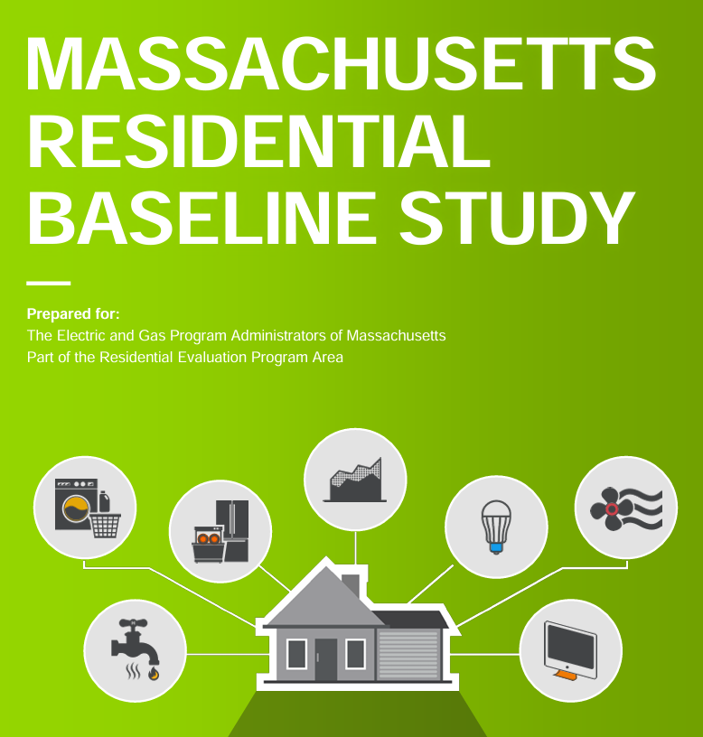
https://ma-eeac.org/wp-content/uploads/NavRes01_ExecSumm_2019_04_15.pdf

Slide 18
How can I reach potential borrowers?
Utility programs do their own direct marketing of energy-saving opportunities, often in direct conjunction with their billing, when customers may be most focused on wanting to reduce their bills.
Many utility programs partner with community-based organizations to help with outreach.
Utility programs also train and assist their contractor networks, assist them with marketing, and have established contractor oversight procedures.
In reality, contractors are generally by far the biggest factor in driving demand, making sales, and bringing pipeline
It is important to ensure consumer protection under that model, which is something community lenders have experience with and can help strengthen.

Slide 19
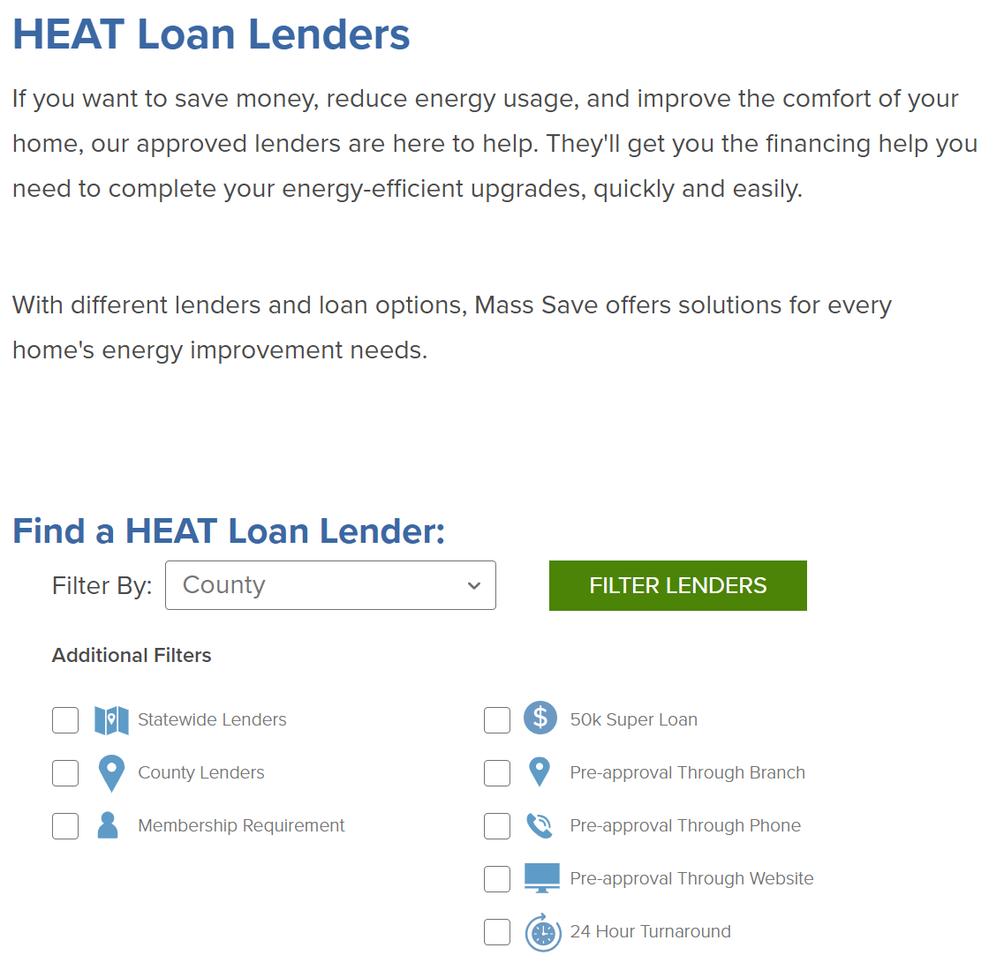
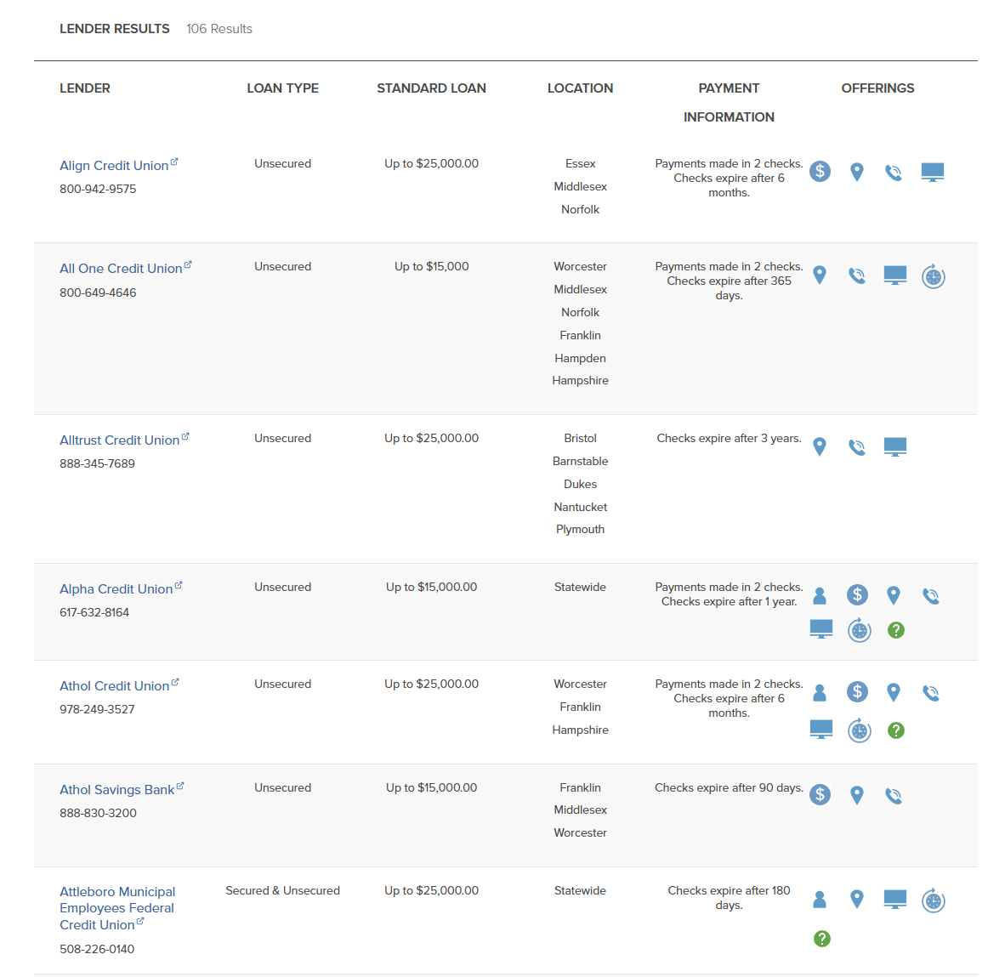
https://www.masssave.com/residential/programs-and-services/financing/heat-loan-lender-list

Slide 20
How can I provide technical assistance to borrowers to help them understand the best opportunities for them?
One of the main functions of utility programs, aside from providing rebates and incentives, is to help educate customers about energy efficiency and clean energy.
Part of that function is carried out through general education and outreach, but it also typically includes direct customer service to help individual customers figure out their energy needs and what projects may be most beneficial to them.
Some programs offer their own energy auditors and energy advisors.

Slide 21
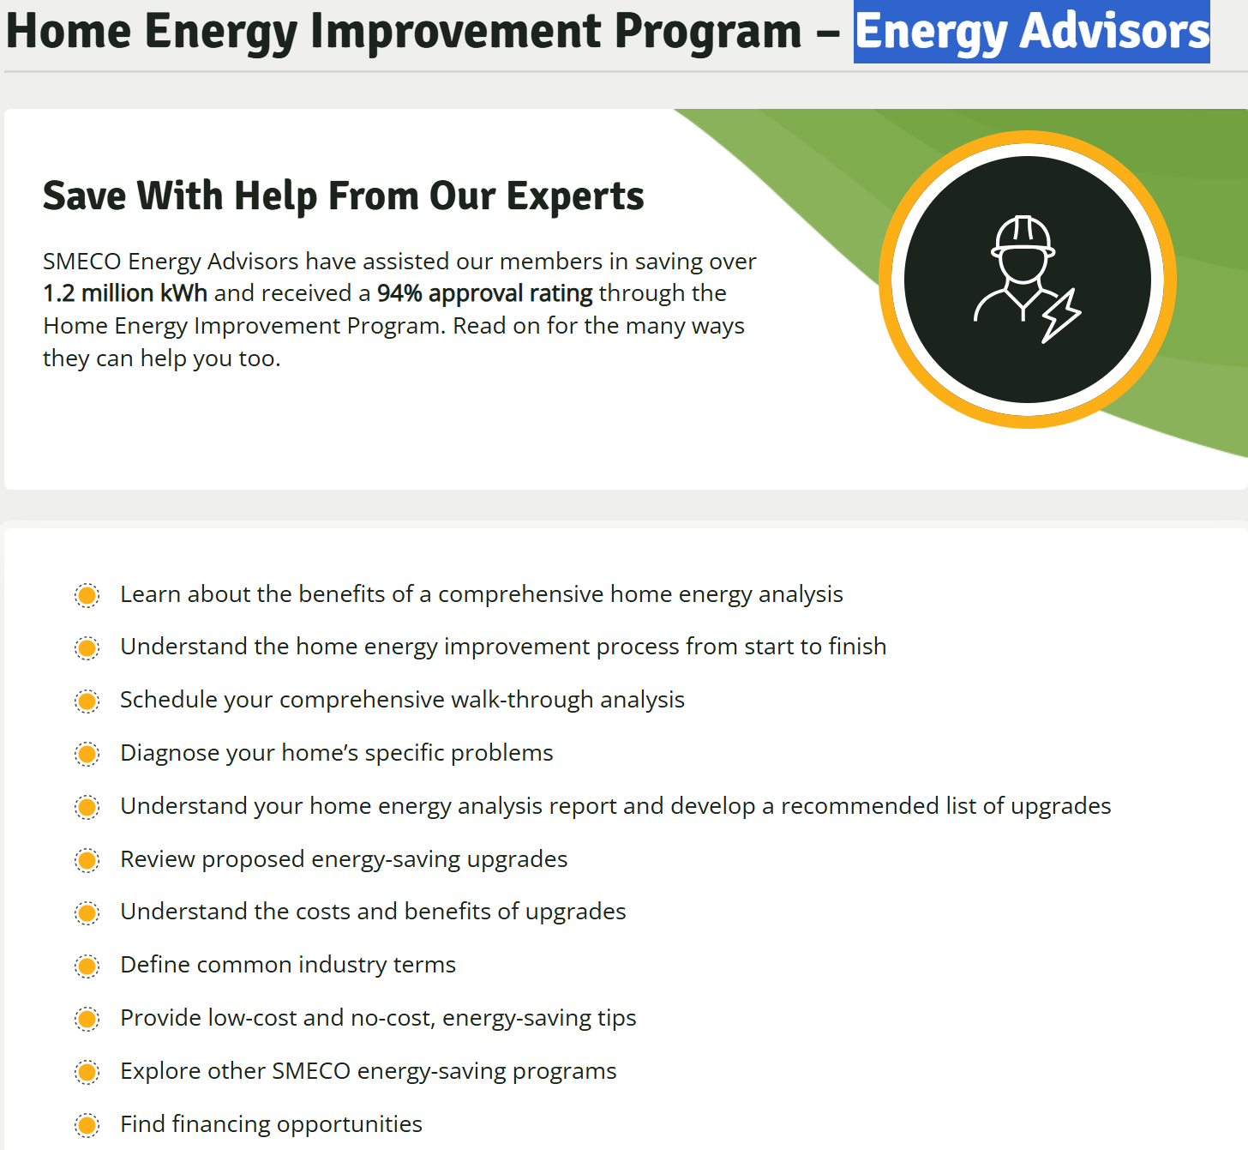
https://www.smeco.coop/energy-efficiency/residential-programs/home-energy-improvement-program/home-energy-analysis/energy-advisors/

Slide 22
How should I set pricing, and how can I offer competitive pricing while managing costs and risks?
Many utility programs offer interest-rate buy-downs to encourage customers to invest in energy efficiency and clean energy, and to make projects more affordable.
Some utility programs also offer loan guarantees or loan-loss reserves.
Longstanding utility financing programs also track and maintain loan performance history, which may be useful in determining appropriate risk-based pricing.

Slide 23
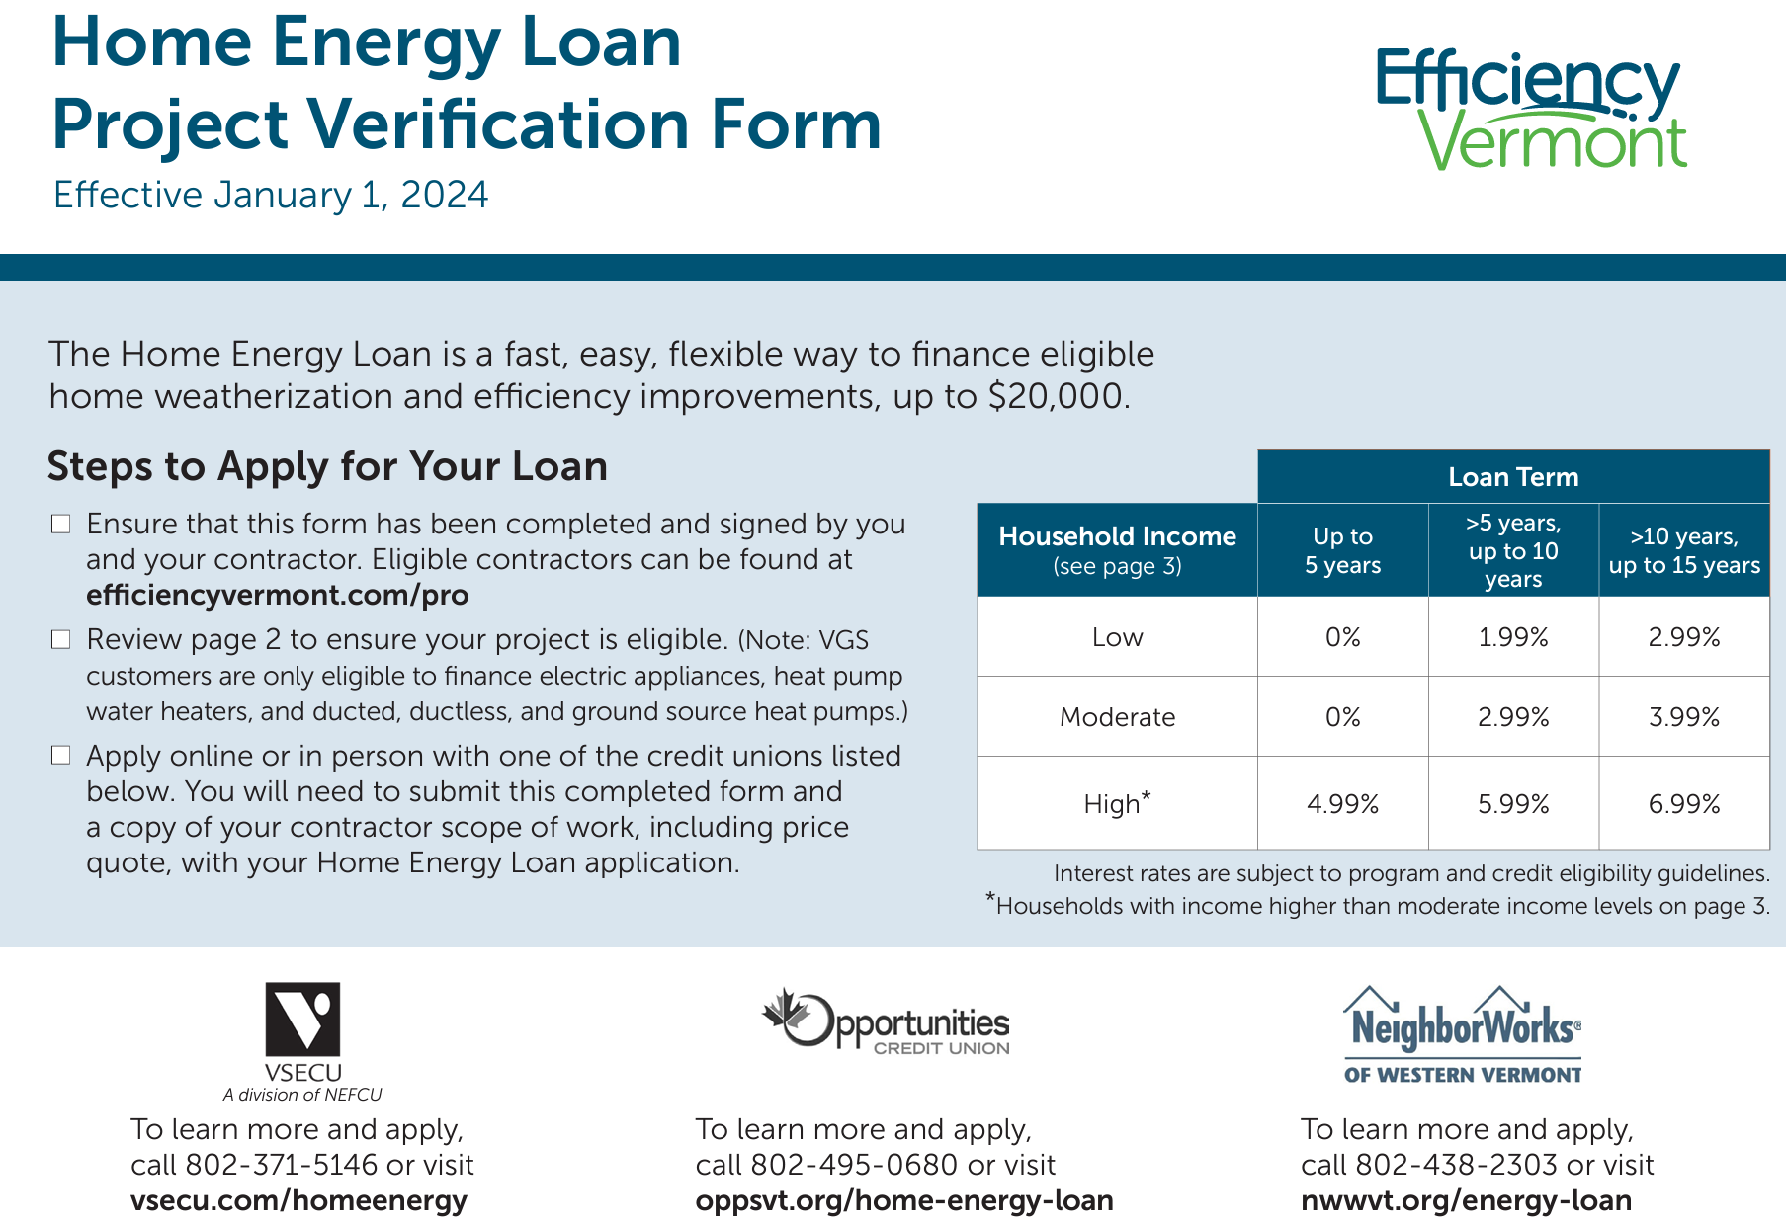
https://www.nwwvt.org/wp-content/uploads/2024/03/efficiency-vermont-home-energy-loan-project-verification-February-29-2024.pdf

Slide 24
How will I know whether my program is effective, and what if any changes I should make?
Utility programs have the resources and tools to evaluate their programs, including their financing offerings.
Program evaluation is not only an integral part of overall utility program management, it is also required by utility regulators.
Utility programs dedicate a portion of their annual budgets to program evaluation and are permitted to recover evaluation costs from customers.

Slide 25
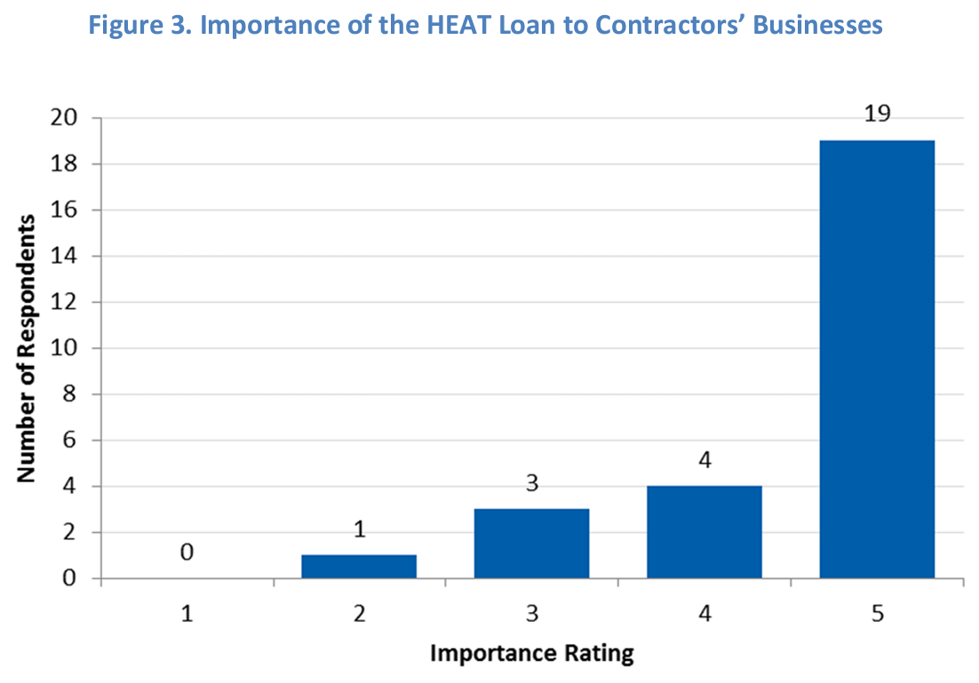
https://ma-eeac.org/wp-content/uploads/HES-and-HEAT-Loan-Program-Assessment-Final-Report.pdf

Slide 26
So how do I partner with my local utility…?
Some of these resources don’t really require a formal partnership.
Reference to utility program technical specifications for project eligibility.
Reference to utility program approved contractors.
To find the best contact for your local utility program:
Check website first, but many of these are customer-facing and don’t list program managers.
Reach out to Association of Energy Service Professionals (AESP) and ask for program contact. AESP is a national membership organization of utility program staff and contracted program management firms.
Reach out to American Council for an Energy-Efficient Economy (ACEEE). ACEEE is the leading national advocacy organization for energy efficiency and has contacts in many utility programs.
Check out the Database of State Incentives for Renewables and Efficiency (DSIRE). Not the most user friendly, but the most comprehensive database of utility programs. Lists organizational contact information but not individual points of contact.

Slide 27
Opportunities for Partnership
CCIA/NCIF Applications:
Consider reaching out to utilities and asking them to review and potentially help provide assistance in your proposed lending program development and implementation. Citing utility program outreach and coordination may strengthen your application.
Internal Capacity Building:
Ask utility program staff whether they would be willing to come in and provide background training on issues and program elements like those described above.
Borrower Technical Assistance:
Refer customers to utility programs for technical assistance with their energy projects.
Consider asking utility staff to help provide education and training to borrowers through lender-sponsored technical assistance and borrower education programs.
Utility Financing Programs:
Many utilities have existing financing programs for customers. Discuss with utilities whether you can help provide assistance with these programs or become a participating lender.
Utilities that do not currently have financing programs may be interested in starting one.

Slide 28
Contact Information
Chris Kramer Clean Energy Financing Consultant CK Financing (202) 351-9154 ckramer@ckfinancing.com www.ckfinancing.com

